Slide 1

ReSourceFul A friendly web app for managing external resources
July 2017

Slide 2
1 The Idea
Open Source culture, Ecosystems, Collaborative communities…
Imagine what you’re doing inherently depends on
“the intelligence of the masses”.

Slide 3
You ask people to share their findings, right? How do you smartly complement the resources in your learning material?

Slide 4
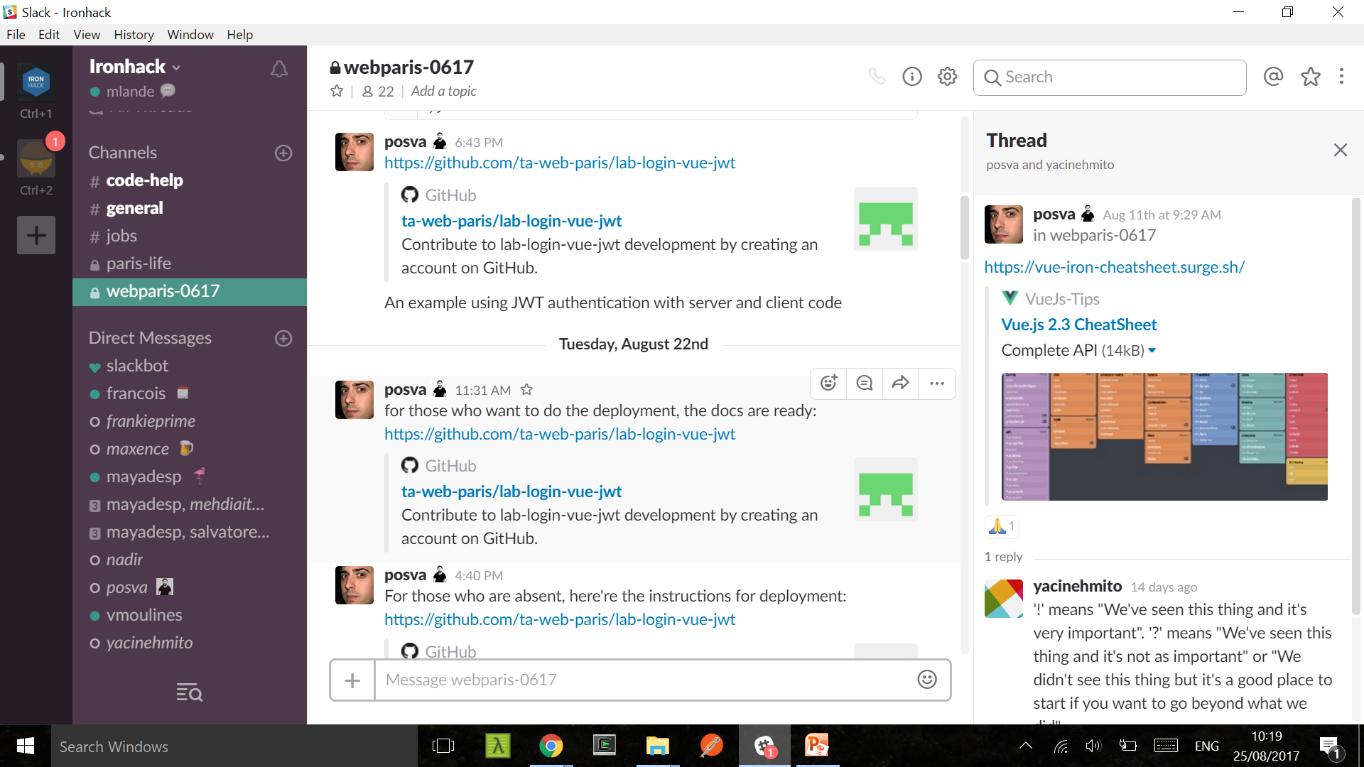

Slide 5
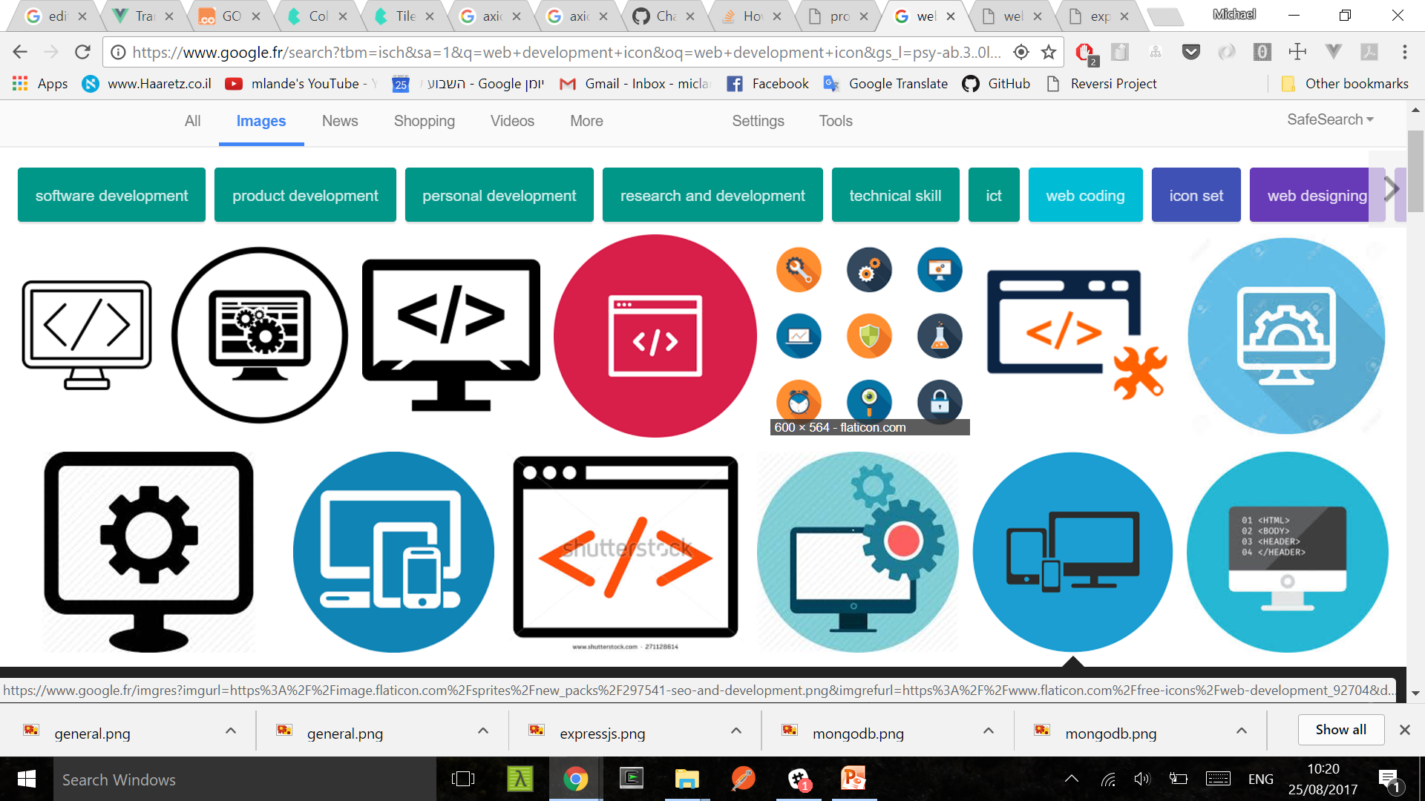

Slide 6
Possible solution: Put it all in one place. Make that place nice and simple.

Slide 7
2 The Implementation

Slide 8
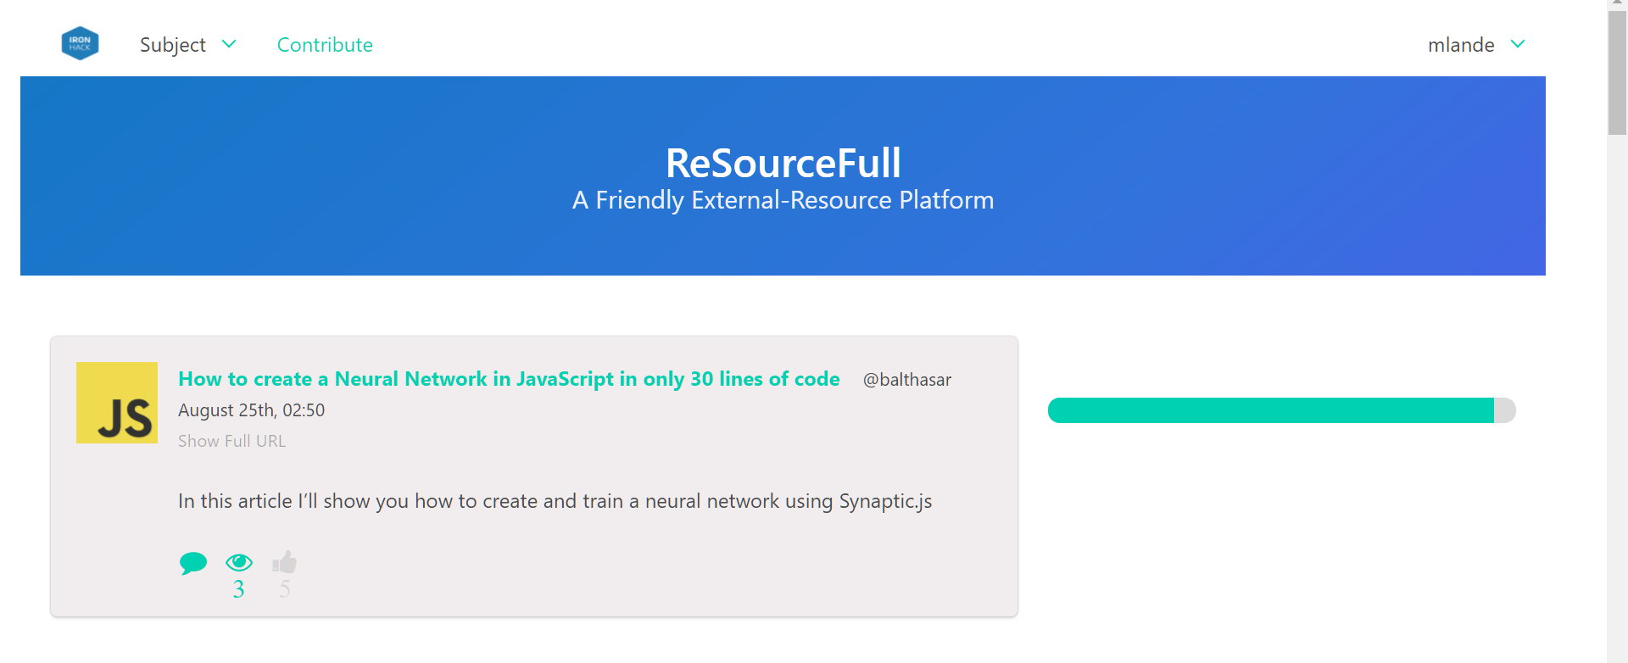
Keep it simple

Slide 9



Use Powerful Framework Combos!

Slide 10
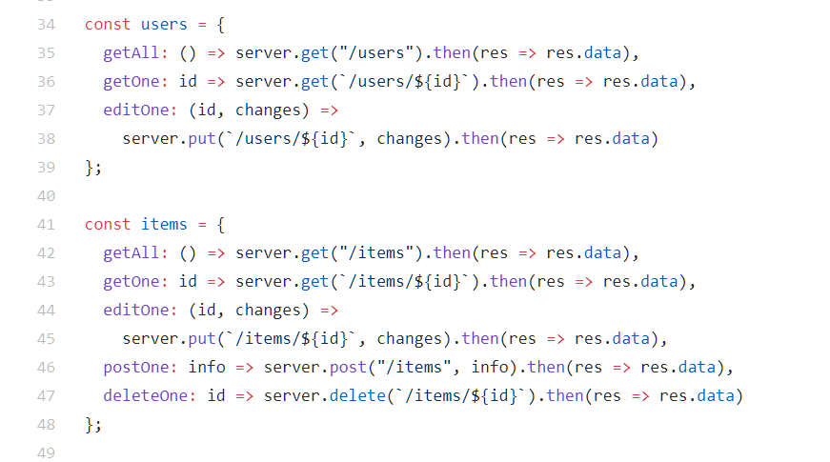
Use Brevity When Possible
(The wonders of ES6)

Slide 11
www.beresourceful.co

Slide 12
3 The Future

Slide 13
Functionality: Search, Suggest Subject, Retrieve Password UX: More modern comment experience, nested comments User Accessibility: Login via original learning platform Dev Accessibility: API guide, administrative roles

Slide 14


Slide 15
Questions ?
July 2017

